Slide 1
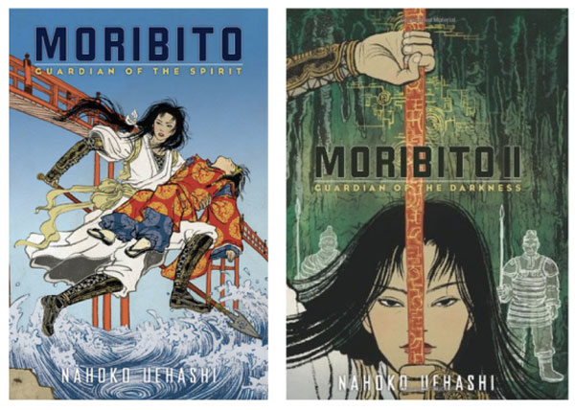
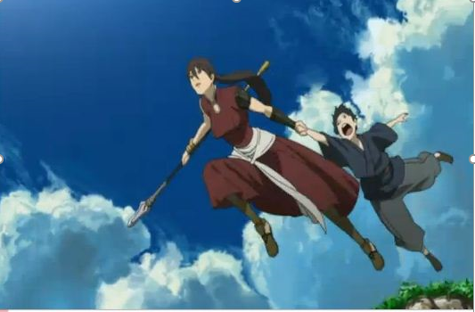

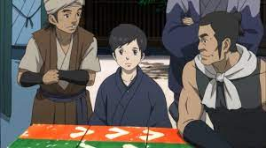
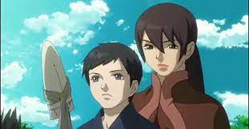
Moribito: Guardian of the Spirit
Is the first in a 12 volume series of fantasy novels by Nahoko Uehashi. It was the Batchelder Award an ALA Notable Children’s Book in 2009. It has been adapted into numerous media including radio, manga, anime, and taiga drama series. Balsa, spear wielder and bodyguard, is a wandering warrior who has vowed to atone for eight deaths in her past by saving an equivalent number of lives. She saves Prince Chagum and is tasked to begin a perilous journey to ensure his survival and discover his mysterious connection to a legendary water spirit.
Moribito Trailer - https://www.youtube.com/watch?v=YbosYHwSVLI
Moribito: Guardian of the Spirit Opening –https://www.youtube.com/watch?v=YHMpso3xkeQ
Favorite Anime Series
#10

Slide 2
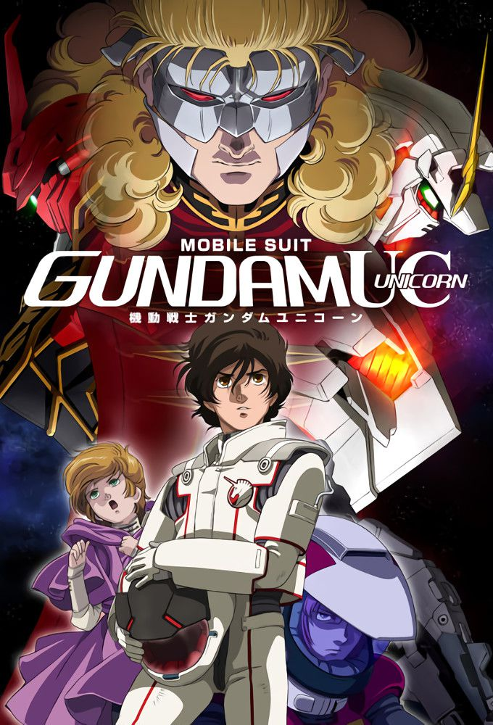
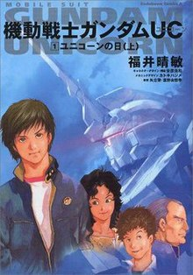
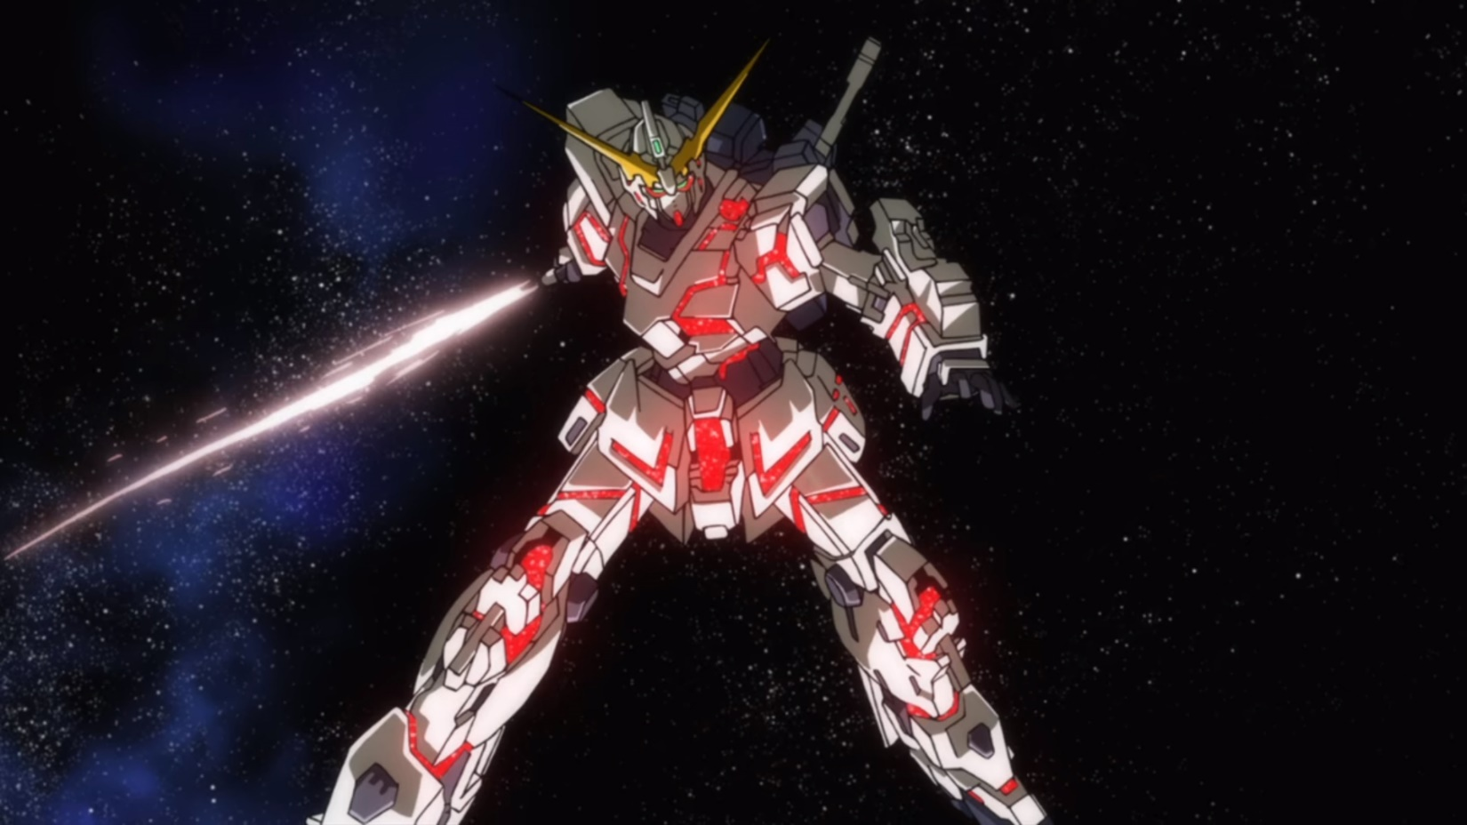
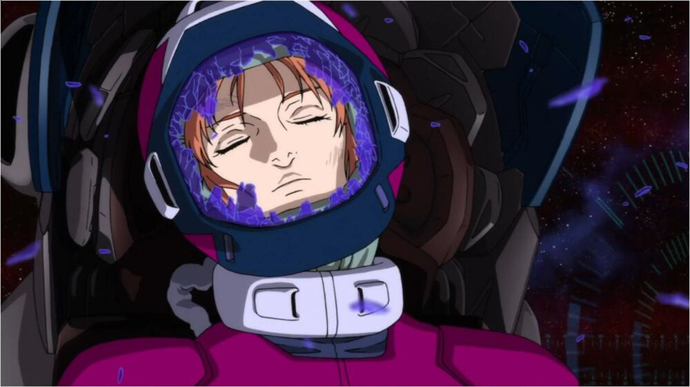
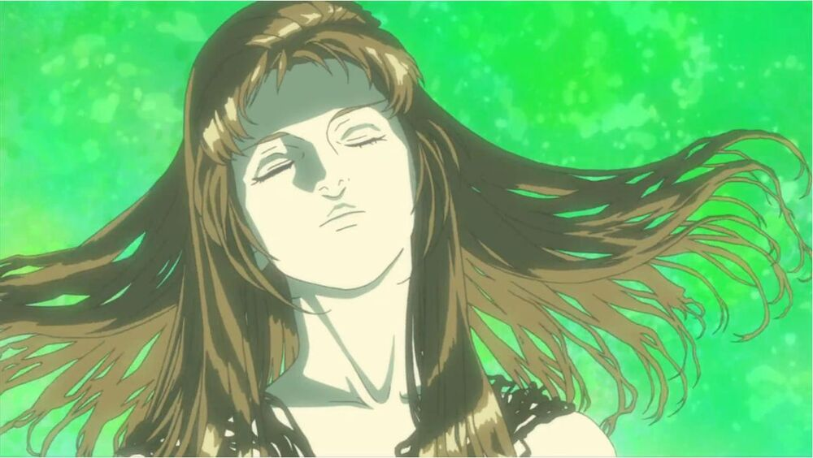
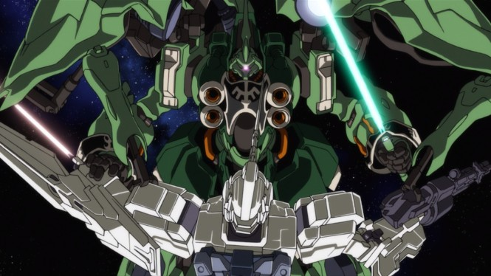
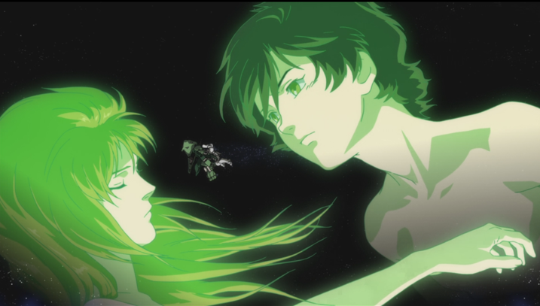
Mobile Suit Gundam Unicorn:
Novel by popular Japanese author Harutoshi Fukui Character and mechanical designs are provided by Yoshikazu Yasuhiko and Hajime Katoki, respectively. The series begins in U.C. 0001, at the very beginning of human space colonization, when Laplace, the residential space station of the Federation's Prime Minister, is destroyed by an anti-federation group during a ceremony hosted by the Prime Minister ushering in the Universal Century Calendar. The main story takes place in UC 0096, revolving around Banagher Links, a seemingly normal boy living and going to school in the space colonies. His life changes one day when he meets a girl named Audrey Burne, as it results in his becoming the pilot of a new Gundam that has connections to an item that is a potential threat to the Federation's existence called "Laplace's Box."
Kshatriya vs Stark Jegan - https://www.youtube.com/watch?v=qc6ME9S_qps
Mobile Suit Gundam Unicorn RE:0096 - Opening 1 | Into the Sky https://www.youtube.com/watch?v=nBfF7n2Flx4
Gundam Unicorn - bL∞dy f8 End Theme 2 (English Sub) https://www.youtube.com/watch?v=8u7wu8PJiPs
Gundam UC RE: I AM https://www.youtube.com/watch?v=dPn1mD0s_R4
Favorite Anime Series
#9
CAGE SawanoHiroyuki[nZk]:Tielle GUNDAM UNICORN SPECIAL MOVIE
https://www.youtube.com/watch?v=mib4SJldGAU

Slide 3
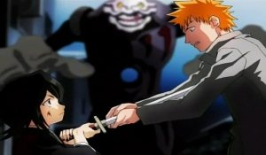


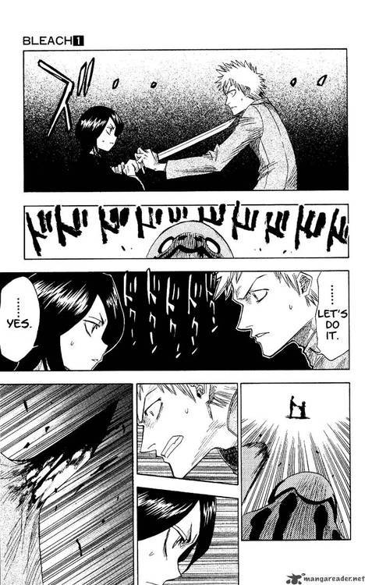
BLEACH: Everything You Need to Know
https://youtu.be/MyCxvvFMka0
Ichigo becomes a Soul Reaper English Dub
https://www.youtube.com/watch?v=0UM2XGXE4DM
Lovely Lovely Nanao-chan -https://www.youtube.com/watch?v=g8_PYNmXeZ8
Bleach: Thousand Year Blood War - Official Trailer https://www.youtube.com/watch?v=iutQJzAXiWo
Manga/Anime series written and illustrated by Tite Kubo. It follows the adventures of the hotheaded teenager Ichigo Kurosaki, who obtains the powers of a Soul Reaper from Rukia Kuchiki. Rukia is also a Soul Reaper, trusted with ushering the souls of the dead from the World of the Living to the Soul Society, and with fighting Hollows. Hollows are a kind of monstrous lost soul who can harm both ghosts and humans. His new-found powers force him to take on the duties of defending humans from these corrupted spirits and guiding departed souls to the afterlife. Prompting him to travel to the Soul Society and on journeys to different realms of existence.
Favorite Anime Series
#8

Slide 4
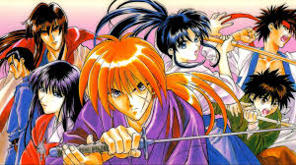
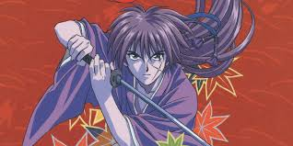
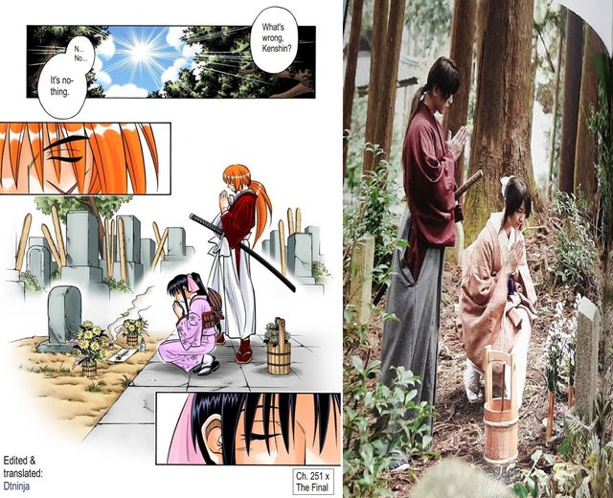
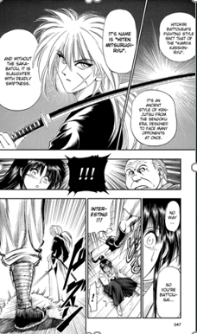


Rurouni Kenshin is a manga/anime series written and illustrated by Nobuhiro Watsuki. The story begins during the 11th year of the Meiji era in Japan (1878). It follows a former assassin known as Hitokiri Battosai. Following the revolution he becomes a wandering swordsman. Kenshin Himura vows to never take another life, now wielding a reverse blade sword.
Kenshin Vs Gohei Hiruma - https://www.youtube.com/watch?v=E58jlYJ6Ipo
Rurouni Kenshin: Meiji Kenkaku Romantan - Official Teaser Trailer
https://www.youtube.com/watch?v=vDVEAm0XUgM
Rurouni Kenshin: The Final/The Beginning (Live Action) -
https://www.youtube.com/watch?v=eAA1ZDSCWjI
Favorite Anime Series
#7

Slide 5
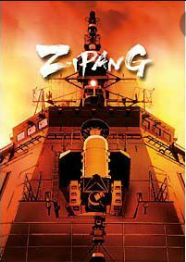
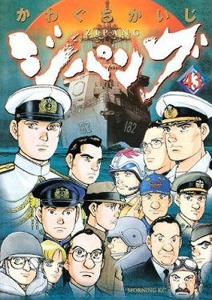
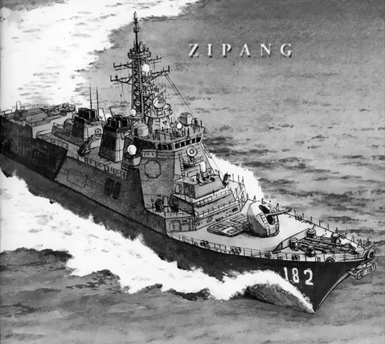
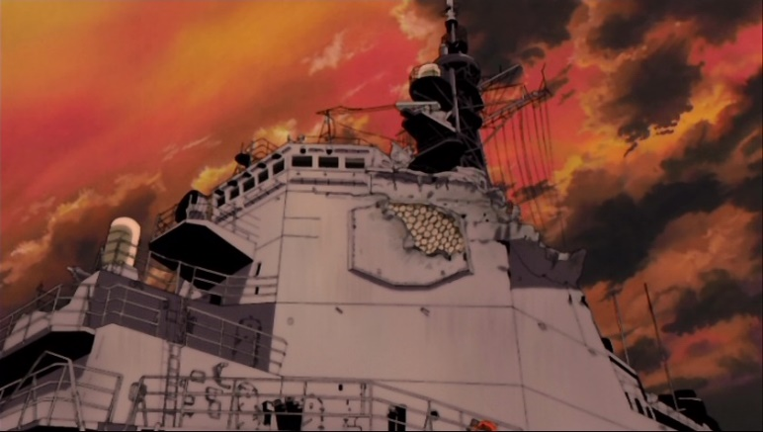
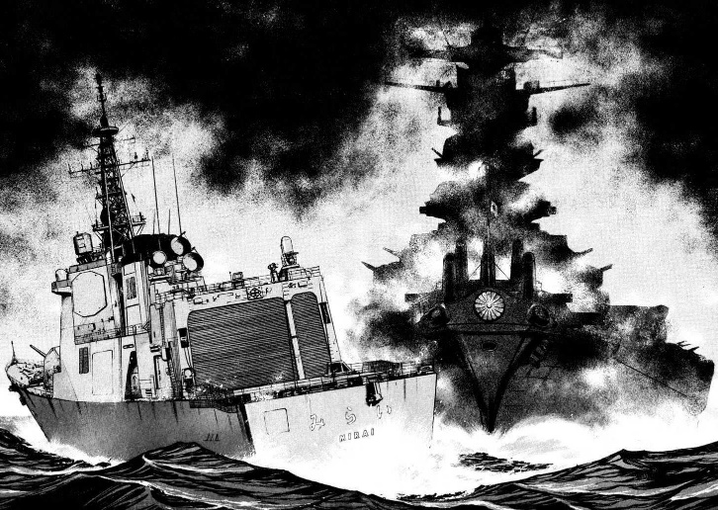
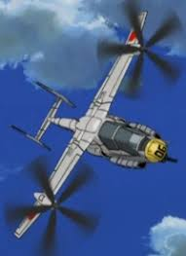
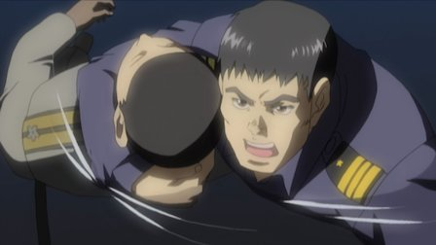
Zipang is a manga/anime written and illustrated by Kaiji Kawaguchi. The newest and most advanced destroyer in the JMSDF DDH-182 Mirai sets sail from Yokosuka on a training exercise with the United States Navy. En route, they encounter a strange meteorological anomaly, which causes them to be transported back in time to June 4, 1942.
Despite their initial attempts not to alter history, they soon find themselves gradually drawn into the war. Their rescue of an IJN Intelligence officer Lt. Cmdr Kusaka from his downed aircraft, causes devastating changes to the timeline when he learns of Japan’s future. He resolves to create a new stronger version of Japan called “Zipang”, no matter what the cost.
Umidori Take-off –
https://www.youtube.com/watch?v=w6I84lxUHbs
Favorite Anime Series
#6

Slide 6
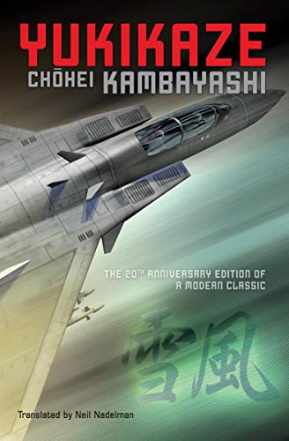

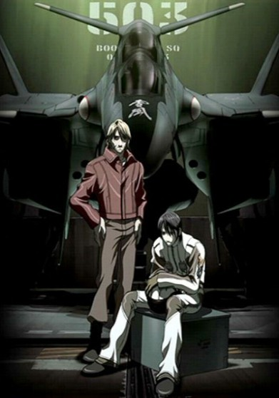
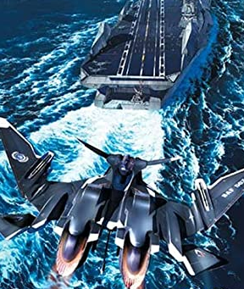

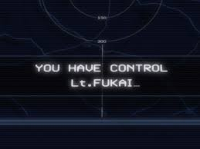
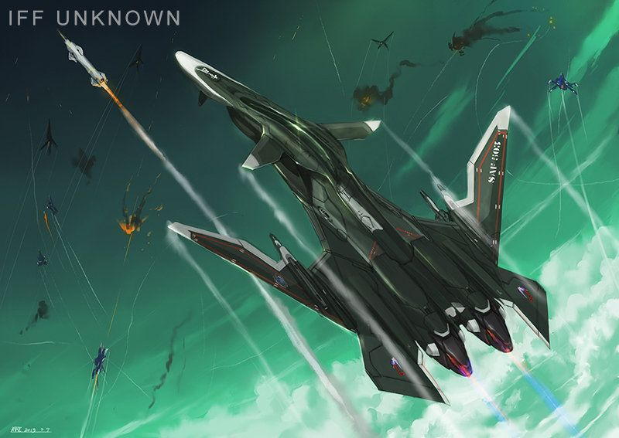
Battle Fairy Yukikaze is a military science fiction series written by Chohei Kambayashi. It was followed by two sequels: Good Luck, Yukikaze and Unbroken Arrow. Thirty-Three years before the events of the series, an alien force known as the JAM invade Earth through a dimensional portal that appeared over Antarctica. The UN establishes a defense force (FAF) that manages to push the enemy back to the other side of the portal. They establish bases on the JAM homeworld, a planet named Fairy. The main character, Lt Rei Fukai, pilots the FFR-31MR/D Super Slyph (later the FFR-41MR Mave) fighter B-503, nicknamed “Yukikaze”, equipped with a near sentient AI. Over the course of the series, Fukai and the FAF struggles to defeat the JAM, who have perfected human cloning and planted agents all over the FAF.
Sentou Yousei Yukikaze OP Engage -
https://www.youtube.com/watch?v=xirg85xQdJE
Yukikaze Trailer - US Official
https://www.youtube.com/watch?v=ZBfvLImfzxI
Yukikaze says it's an enemy
https://www.youtube.com/watch?v=nxYVMVjqj1s
Favorite Anime Series
#5

Slide 7
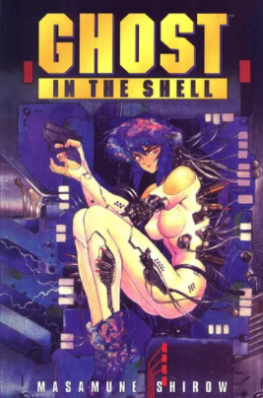
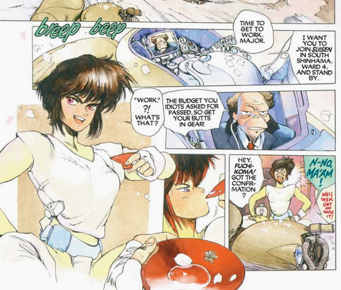
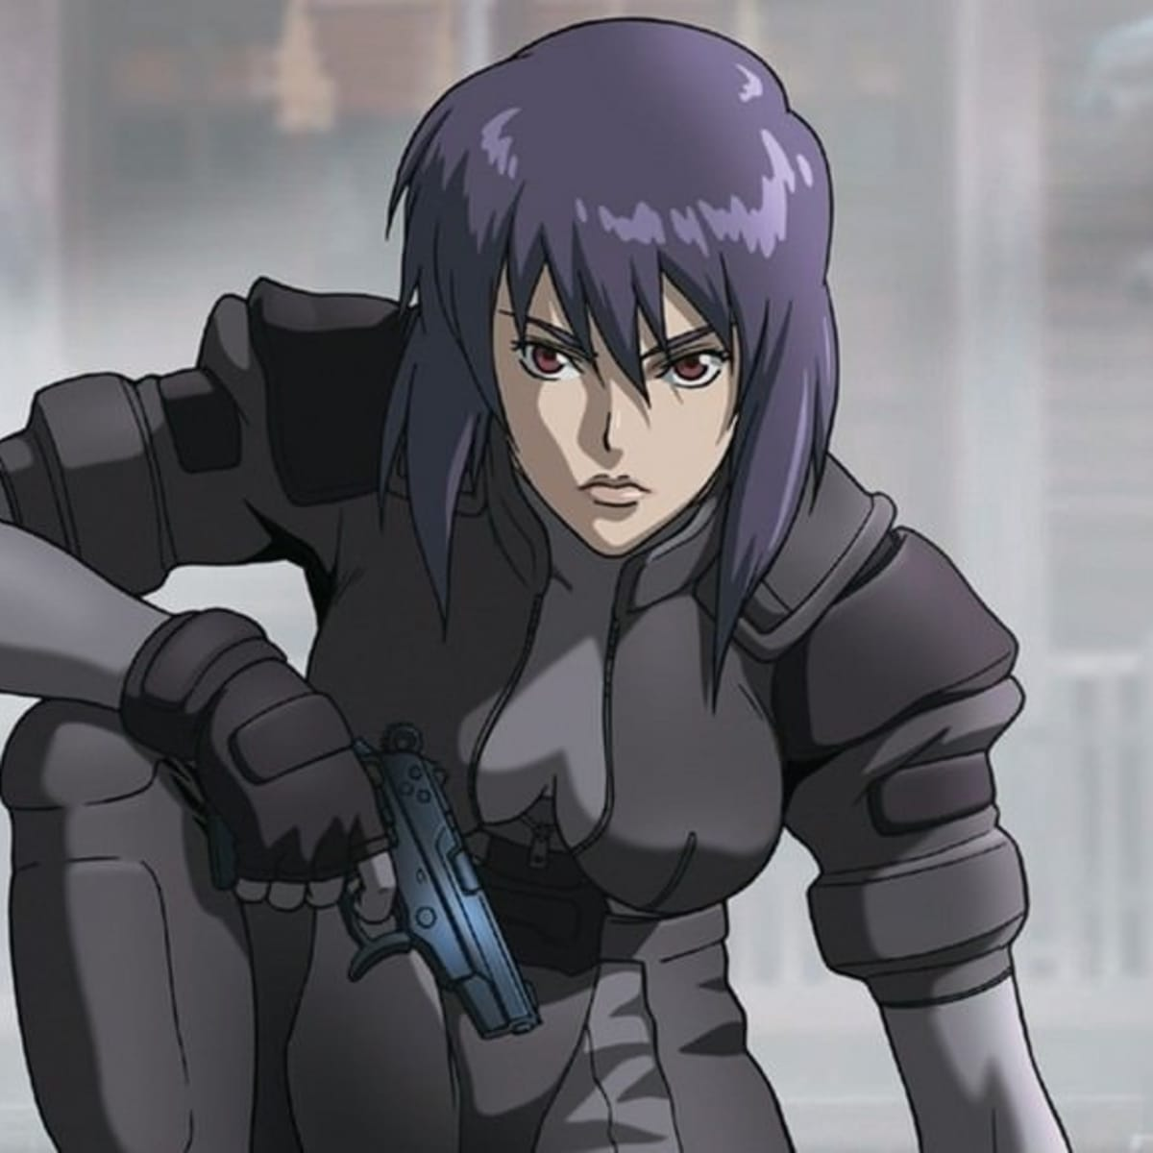
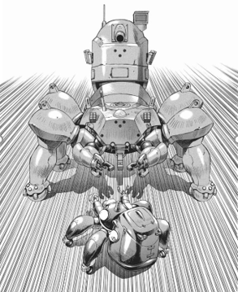
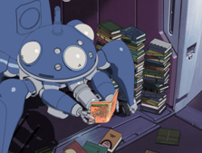
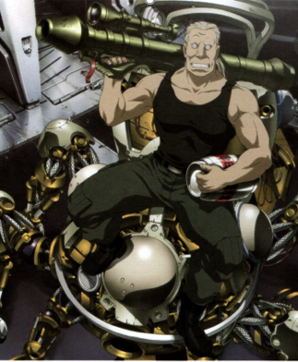
Ghost In the Shell Stand Alone Complex S01e02 'testation' tank clip
https://www.youtube.com/watch?v=s2MVaLEEnLs
Ghost in the Shell: SAC renegade tank scene
https://www.youtube.com/watch?v=LLvlozh6ysY
Ghost in the Shell: SAC Testation clip
https://www.youtube.com/watch?v=blj161e5Bqs
Tachikoma Explains Individuality And God
https://www.youtube.com/watch?v=lNY53tZ2geg
Cyberpunk anime/manga franchise written and illustrated by Masamune Shirow.The story of a counter-cyberterrorist organization Public Security Section 9, led by Major Motoko Kusanagi. Computer Technology has advanced to the point that members of the public possess cyberbrains, that allows them to interface their biological brain with various networks. This can also be combined with various levels of protheses, (including full body prosthetic) enabling a person to become a cyborg.
Favorite Anime Series
#4

Slide 8

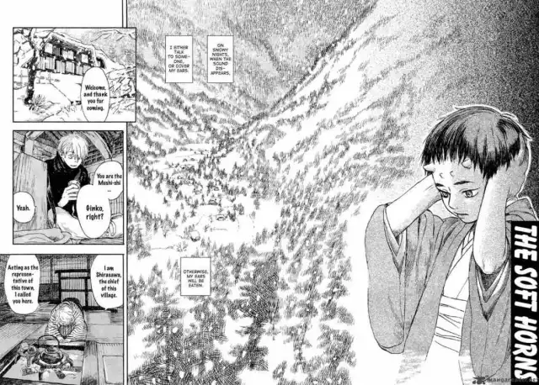
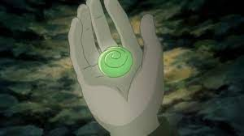
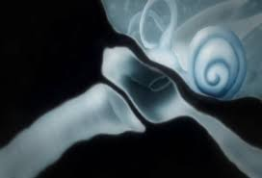
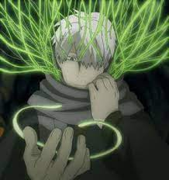
Mu Shi Shi is a manga/anime series originally written and illustrated by Yuki Urushibara.
The series follows Ginko, a man who dedicates himself to keeping people protected from supernatural creatures called Mushi.
Mu Shu Shi Volume 1 Trailer - https://www.youtube.com/watch?v=StCN_4qWfWE
Mu Shi Shi “The Sore Feet Song” - https://www.youtube.com/watch?v=_rWCZyjRa0Q
Favorite Anime Series
#3

Slide 9
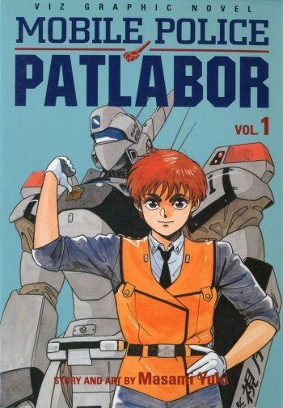
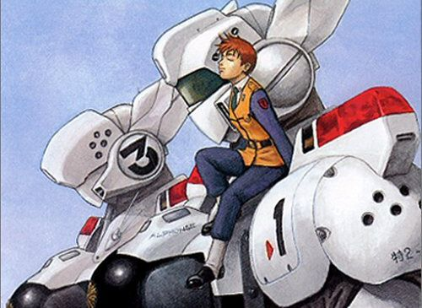

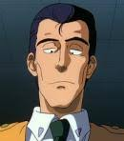
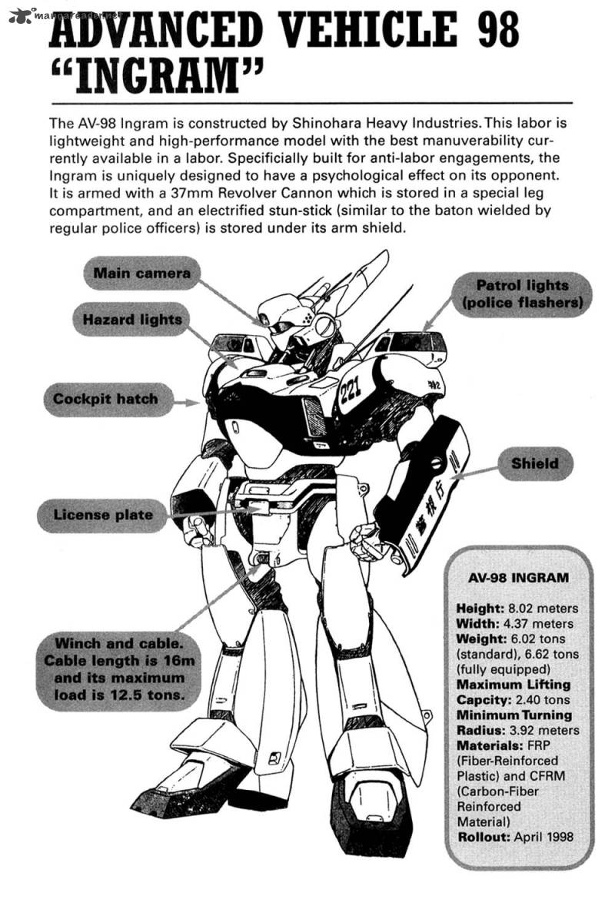
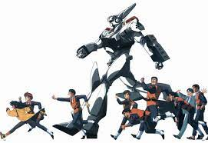
Patlabor OVA Episode 1 - https://www.youtube.com/watch?v=9yaYWjczTgo
Patlabor 2 Opening - https://www.youtube.com/watch?v=enwTApkJ0cc
Patlabor: The Next Generation Episode 0 - https://www.youtube.com/watch?v=6niCpChAJMM
Favorite Anime Series
#2
Mobile Police Patlabor is a science fiction franchise created by “Headgear”, a group consisting of manga artist Masami Yuki, director Mamoru Oshii, screenwriter Kazunori Ito, mecha designer Yutaka Izubuchi, and character designer Akemi Takada. The story takes place in what was, at the time of release, the near future of 1998 – 2002. Mecha called “Labors” are developed for heavy construction work. The Tokyo Metropolitan Police have their own Patrol Labors to combat crimes, terrorism and accidents involving Labors. Stories revolve around Special Vehicles Section 2. Noa Isumi with her AV-98 Ingram “Alphonse” maybe the main protagonist, but all of Division 2 play major roles.

Slide 10
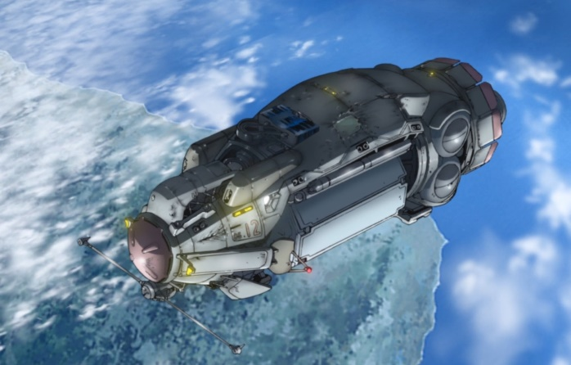
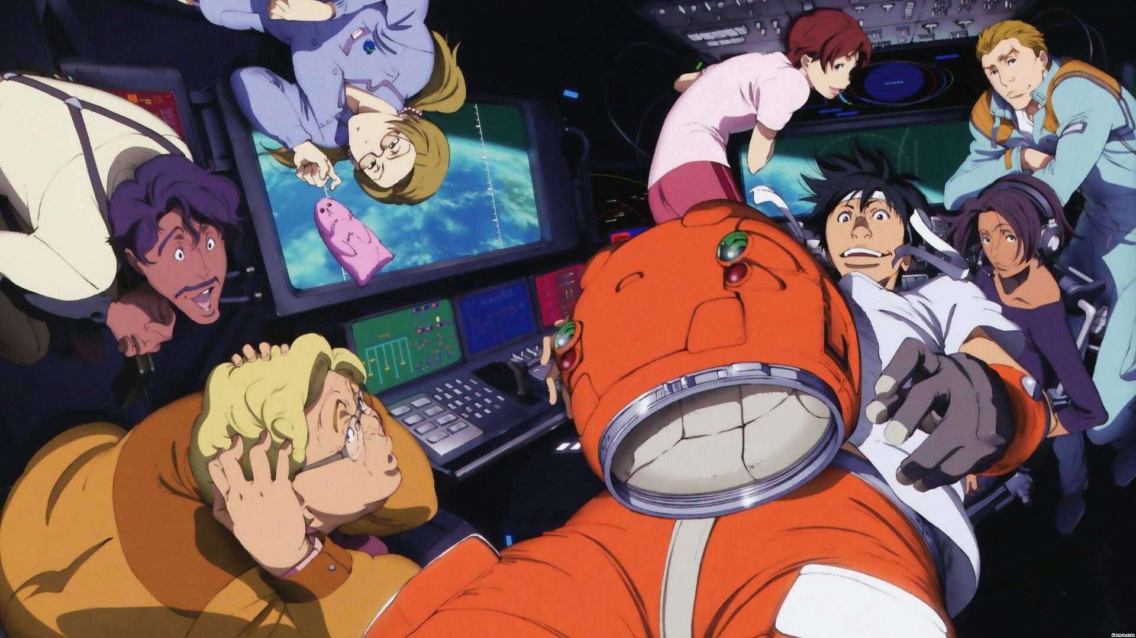
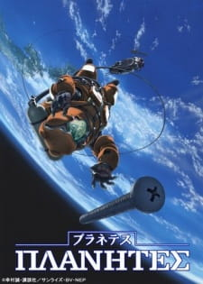
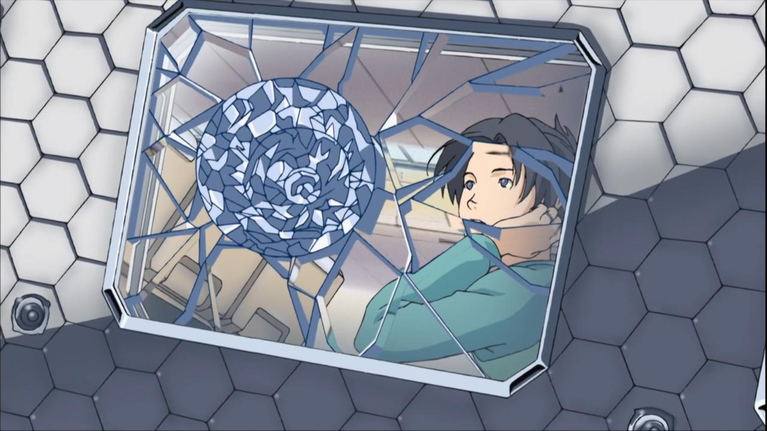
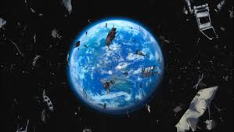
Planetes:
Makoto Yukimura’s anime/manga series
(1999-2004)
Seiun award for best science fiction series.
(Manga 2002 & Anime in 2005)
“Abandoned artificial satellites.
Tanks jettisoned from shuttles.
Debris generated during space station construction.
This vast amount of junk floating in space
Space debris, is a very serious threat. This is a story of 2075, a time in which this space garbage has become a problem.”
The story of Planetes follows the crew of the DS-12 “Toy Box” of the Space Debris Section, a unit of the Technora Corporation.
The Japanese Space Agency JAXA served as a technical consultant to the series.
# 1 Favorite Anime Series
“Opening & Closing Credits” (Subtitled) - https://www.youtube.com/watch?v=MbswxTgXoWI
“All You Can See is the Earth” - https://www.youtube.com/watch?v=opf3j4dF4SM

Slide 11
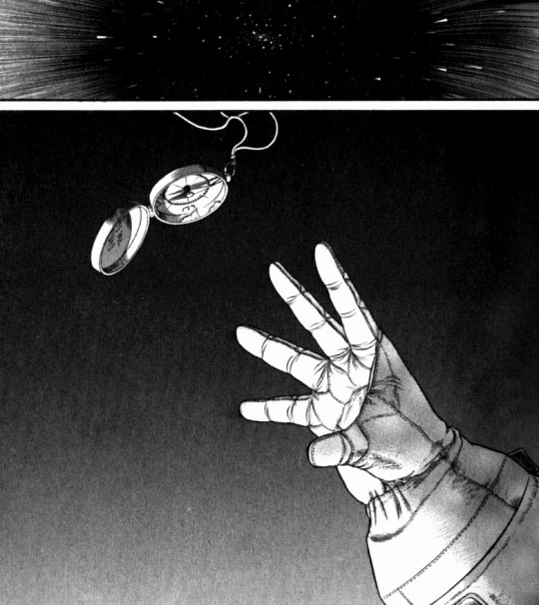





Episode 10 “A Sky Full of Stardust” (Subtitled) - https://www.youtube.com/watch?v=csN_b5oHGXo

Slide 12





Bonus
Dr.STONE is a Japanese anime/manga series written by Riichiro Inagaki and illustrated by the South Korean artist Boichi. The show follows Senku, a high school genius who dedicates himself to rebuilding human civilization after a mysterious event transforms all humans into stone for thousands of years. When he wakes up, he finds that the humans who remain have been reduced to a Stone Age. With each episode of the series, we learn about useful scientific facts. Almost all of the facts and experiments are actually correct. This makes the series all the more fascinating to watch. However, most of the scientific facts are accurate in principle only and does not always apply in real world applications. Dr. Stone is impeccable in educating the viewers about the inventions that are already parts of our daily lives.
“It’s not that there are things that science can’t explain. You look for the rules behind those things. Science is just a name for the steady, pain-in-the-ass effort that goes behind it.” - Senku
Dr Stone: A Stone World! https://www.youtube.com/watch?v=9oTIuknrMB4
Dr Stone: Glasses https://www.youtube.com/watch?v=U_iQcjzzIUs
Dr Stone: The deadly Sulfuric Acid https://www.youtube.com/watch?v=F0l6dr49MG0
Dr Stone: Chrome almost got killed by Sulfuric Acid https://www.youtube.com/watch?v=a7G4X1c95RE
Kari Byron (MythBusters) Reacts to Dr. STONE
https://www.youtube.com/watch?v=HpV85d1hm6I
Favorite Anime Series Bonus

